Slide 1

Chandigarh University
Department of Mathematics
B.Tech. CSE (Core/DS/IT/CC)
Semester-3
Subject Code:25MTT-202
Discrete Mathematics
Unit-2 (Chapter- 2.3.2)
Dr. SARTAJ
DISCOVER . LEARN . EMPOWER

Slide 2

CO mappings

Slide 3

CO-PO mappings
Note: Degree of relevance/correlation: 1-Low, 2-Medium, 3-High, Blank or ‘- ‘- Nil

Slide 4
Topics Covered
Recursive functions
Related Examples
Conclusions
Video links
References

Slide 5
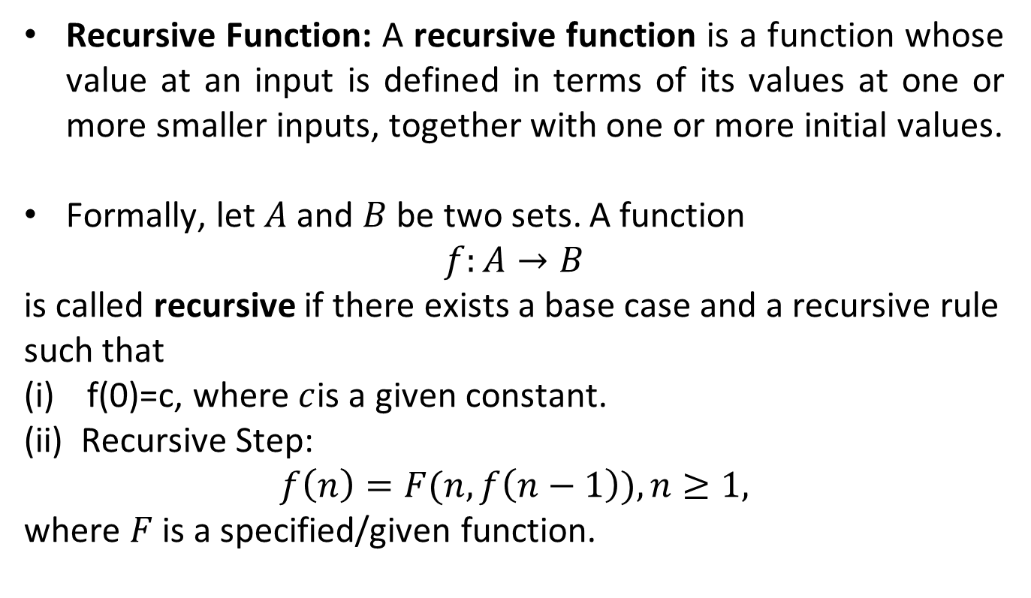
Recursive Function
Recursive Function: A recursive function is a function whose value at an input is defined in terms of its values at one or more smaller inputs, together with one or more initial values.
Formally, let $A$ and $B$ be two sets. A function
$$f:A→B$$
is called recursive if there exists a base case and a recursive rule such that
f(0)=c, where $c$is a given constant.
(ii) Recursive Step:
$$f\left(n\right)=F(n,f\left(n−1\right)), n≥1,$$
where $F$ is a specified/given function.

Slide 6
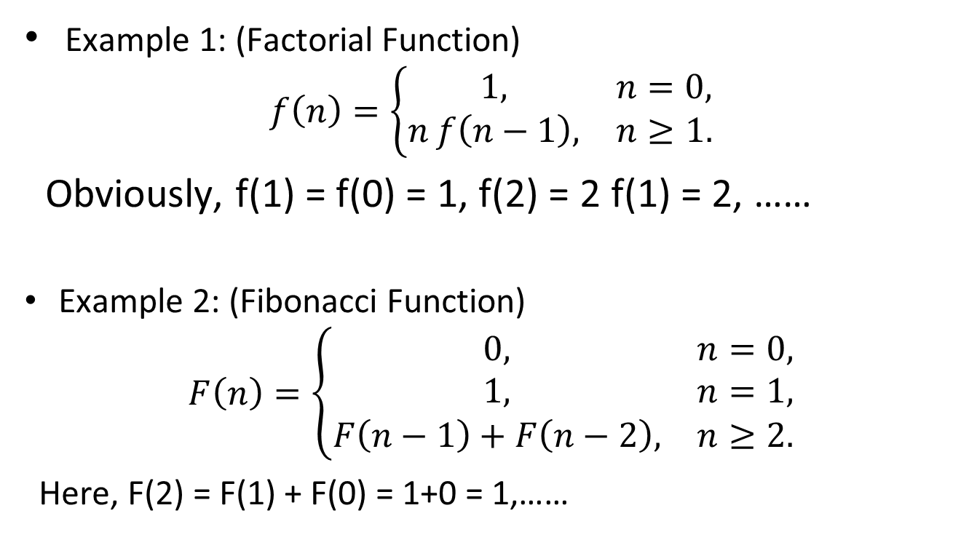
Examples of Recursive Functions
Example 1: (Factorial Function)
$$f\left(n\right)=\left\{\begin{matrix}1, & n=0, \\ n f\left(n−1\right), & n≥1.\end{matrix}\right.$$
Obviously, f(1) = f(0) = 1, f(2) = 2 f(1) = 2, ……
Example 2: (Fibonacci Function)
$$F\left(n\right)=\left\{\begin{matrix}0, & n=0, \\ 1, & n=1, \\ F\left(n−1\right)+F\left(n−2\right), & n≥2.\end{matrix}\right.$$
Here, F(2) = F(1) + F(0) = 1+0 = 1,……

Slide 7
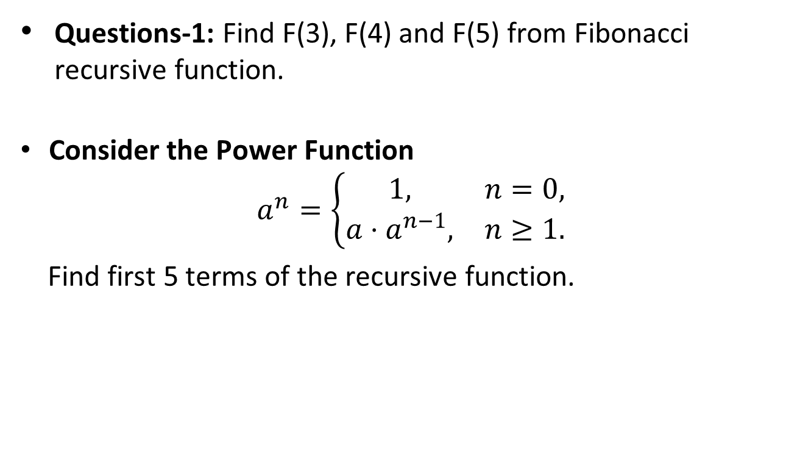
Activity
Questions-1: Find F(3), F(4) and F(5) from Fibonacci recursive function.
Consider the Power Function
$$a^{n}=\left\{\begin{matrix}1, & n=0, \\ a⋅a^{n−1}, & n≥1.\end{matrix}\right.$$
Find first 5 terms of the recursive function.

Slide 8
Conclusion
Recursive function have been discussed in this topic.
Related examples and applications are given.
ns

Slide 9
Video Links
https://youtu.be/dxyYP3BSdcQ?si=fGvl5x7f_5O2m4wc

Slide 10
References
Sr. No. | Author | Name of the Book | Publisher | Year of Publication
1 | B.S. Grewal | Engineering Mathematics – I | Khanna Publishers | 2017
2 | B.V. Ramana | Higher Engineering Mathematics | Tata McGraw-Hill Education | 2009
3 | Erwin Kreyszig | Advanced Engineering Mathematics | Wiley | 2011
4 | N.P. Bali and Manish Goyal | Engineering Mathematics – I | Laxmi Publications | 2015
5 | S.K. Gupta | Mathematical Methods for Engineers | Wiley India | 2013

Slide 11
Thanks!!!

